Slide 1
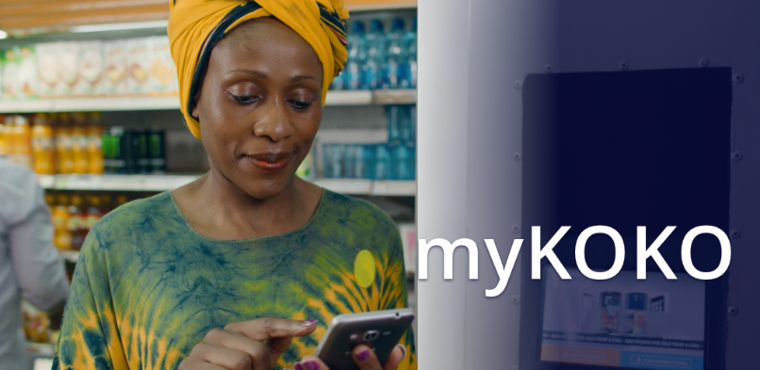
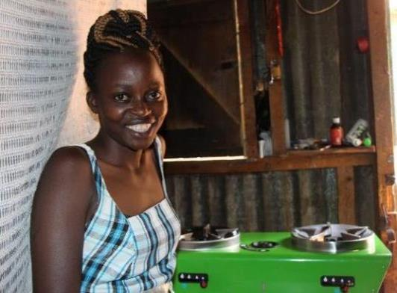

NAIROBI SOFT LAUNCH – PROGRESS UPDATE
November 2017
Greg Murray, CEO g.murray@kokonetworks.com
© 2017 KOKO Networks Limited – Proprietary & Confidential

Slide 2


KOKO HAS FOUR CLEAR OBJECTIVES FOR THE SOFT LAUNCH
1
2
3
4
Achieve “Proof of Concept” for technology suite
Gather Data for input to Hard Launch Marketing Strategy
Enable Launch of OilCo Concession Process
Build Agent Pipeline for Hard Launch
SOFT LAUNCH IS NOT ABOUT TESTING CONSUMER DEMAND

Slide 3
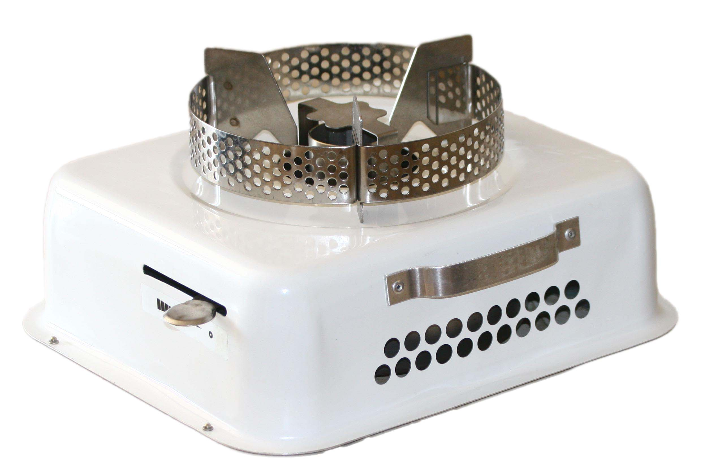
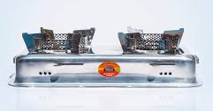


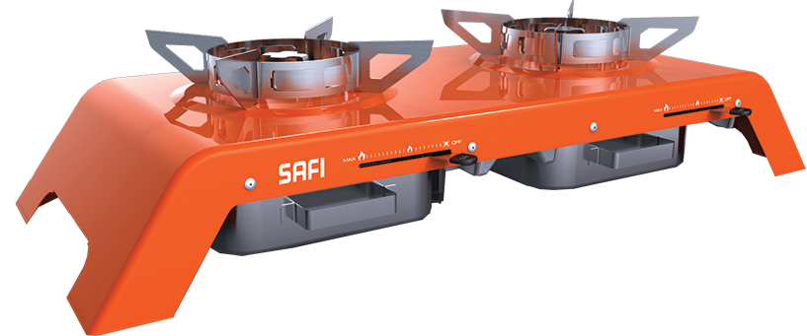

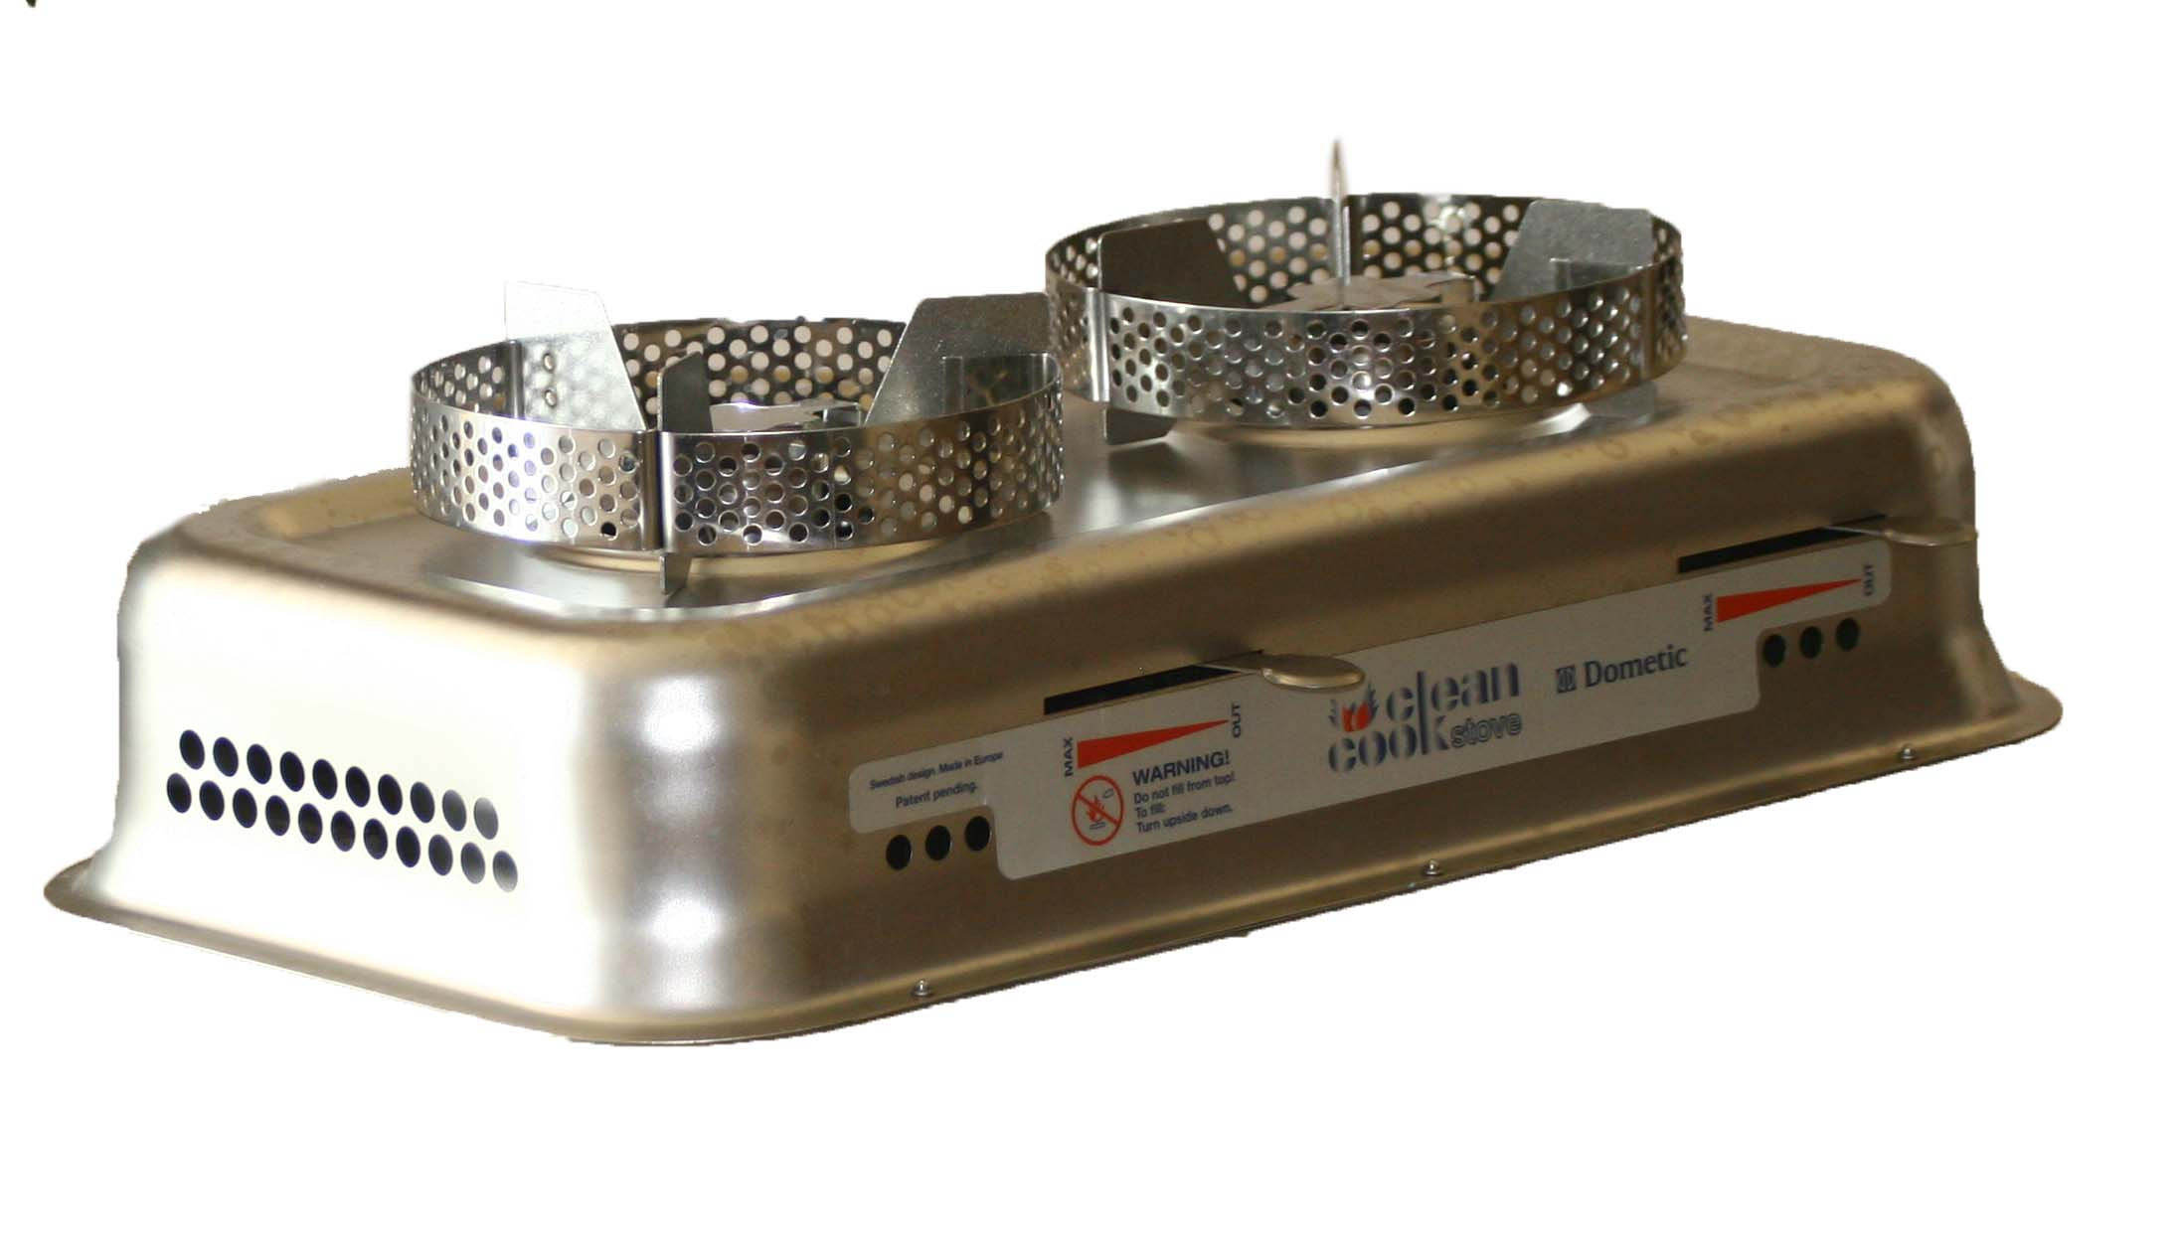
CONSUMER DEMAND FOR ETHANOL COOKING FUEL IS PROVEN
Country | Company | Appliance | Appliance Retail Price | Fuel Price | Traction
Mozambique | CleanStar / NDZiLO |  | $45 | $1.65 / L | 37,000 households
Kenya |  |  | $45 | $1.25 / L | 8,000 households
Haiti | Novogaz |  | $50 | $1.20 / L | 6,000 households

Slide 4
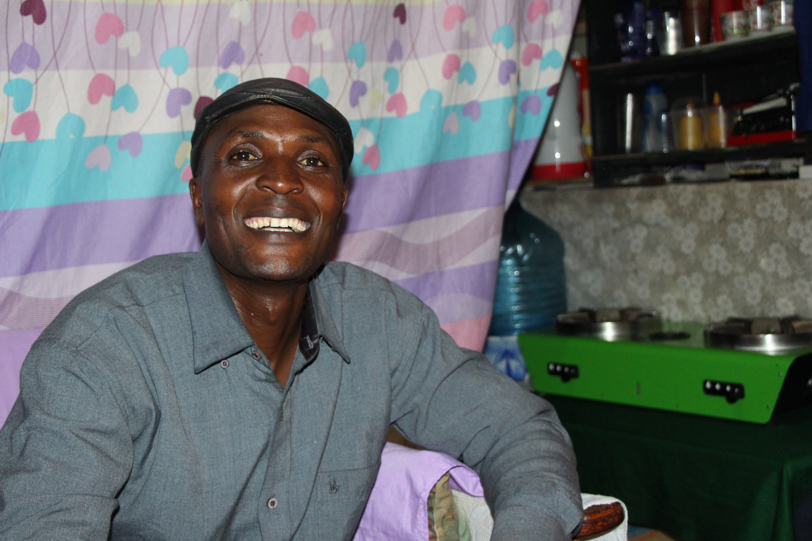
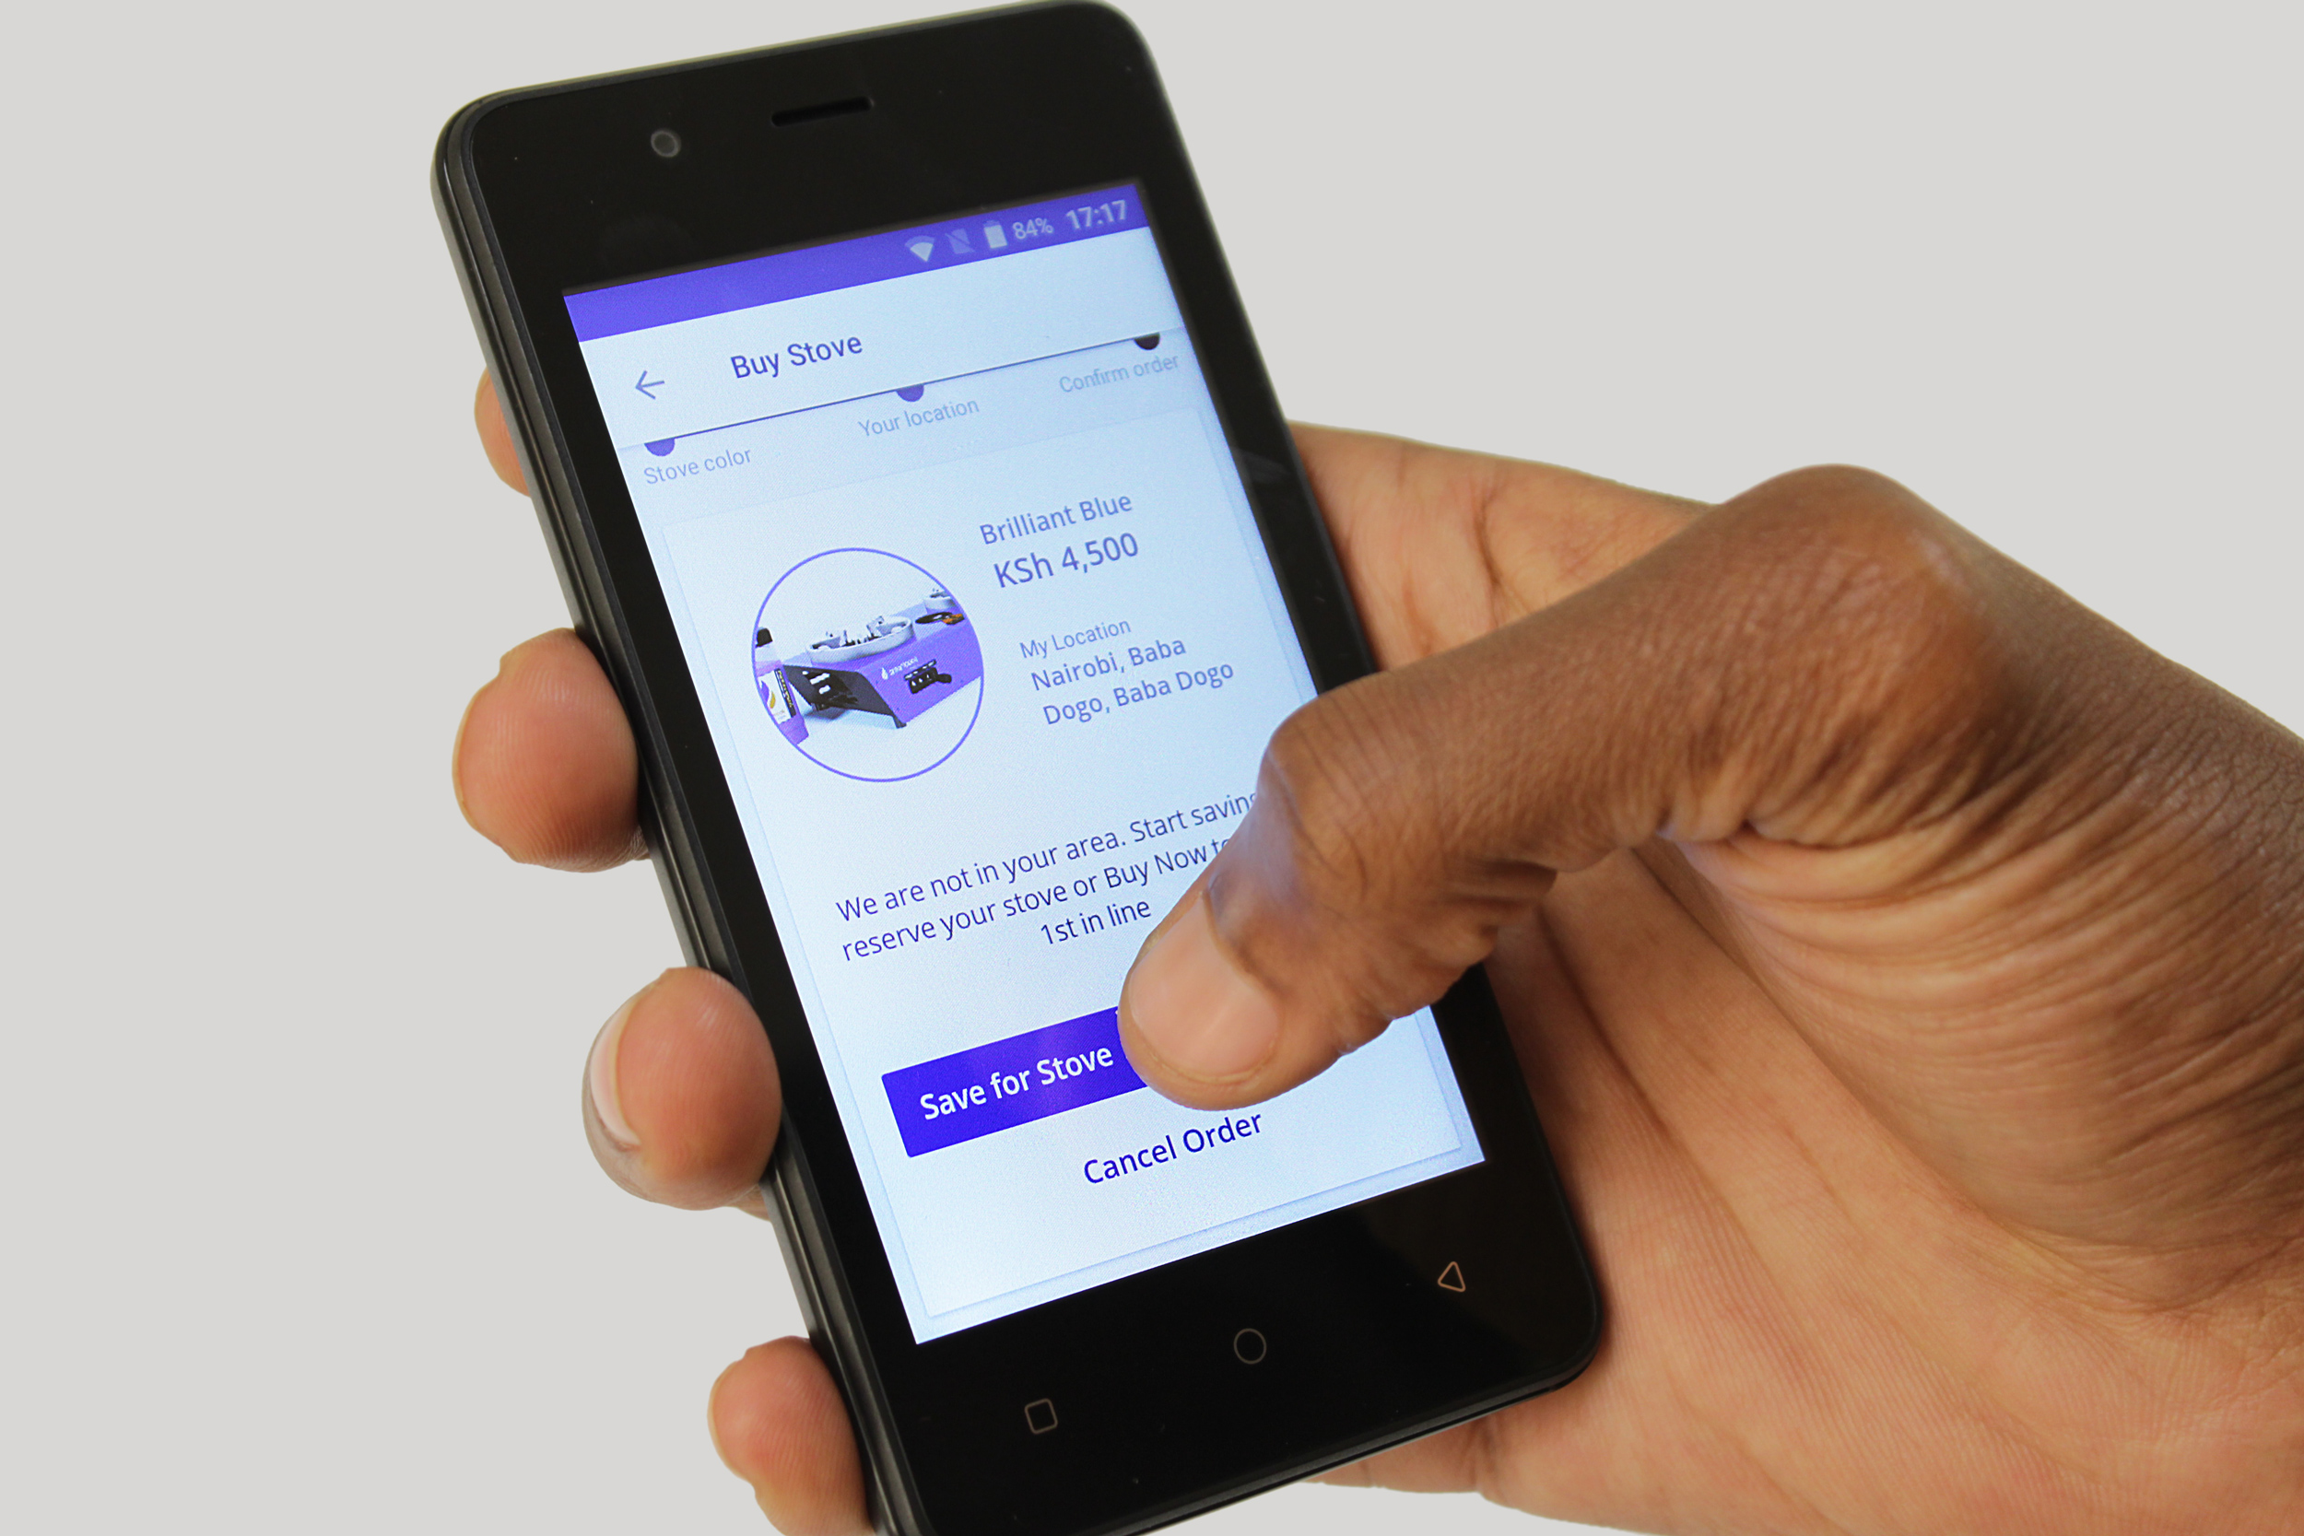
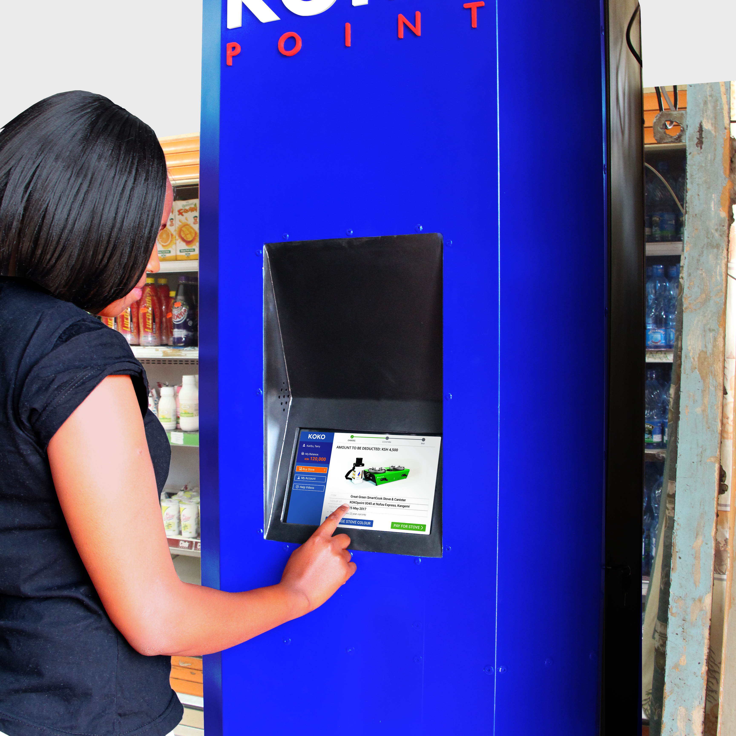
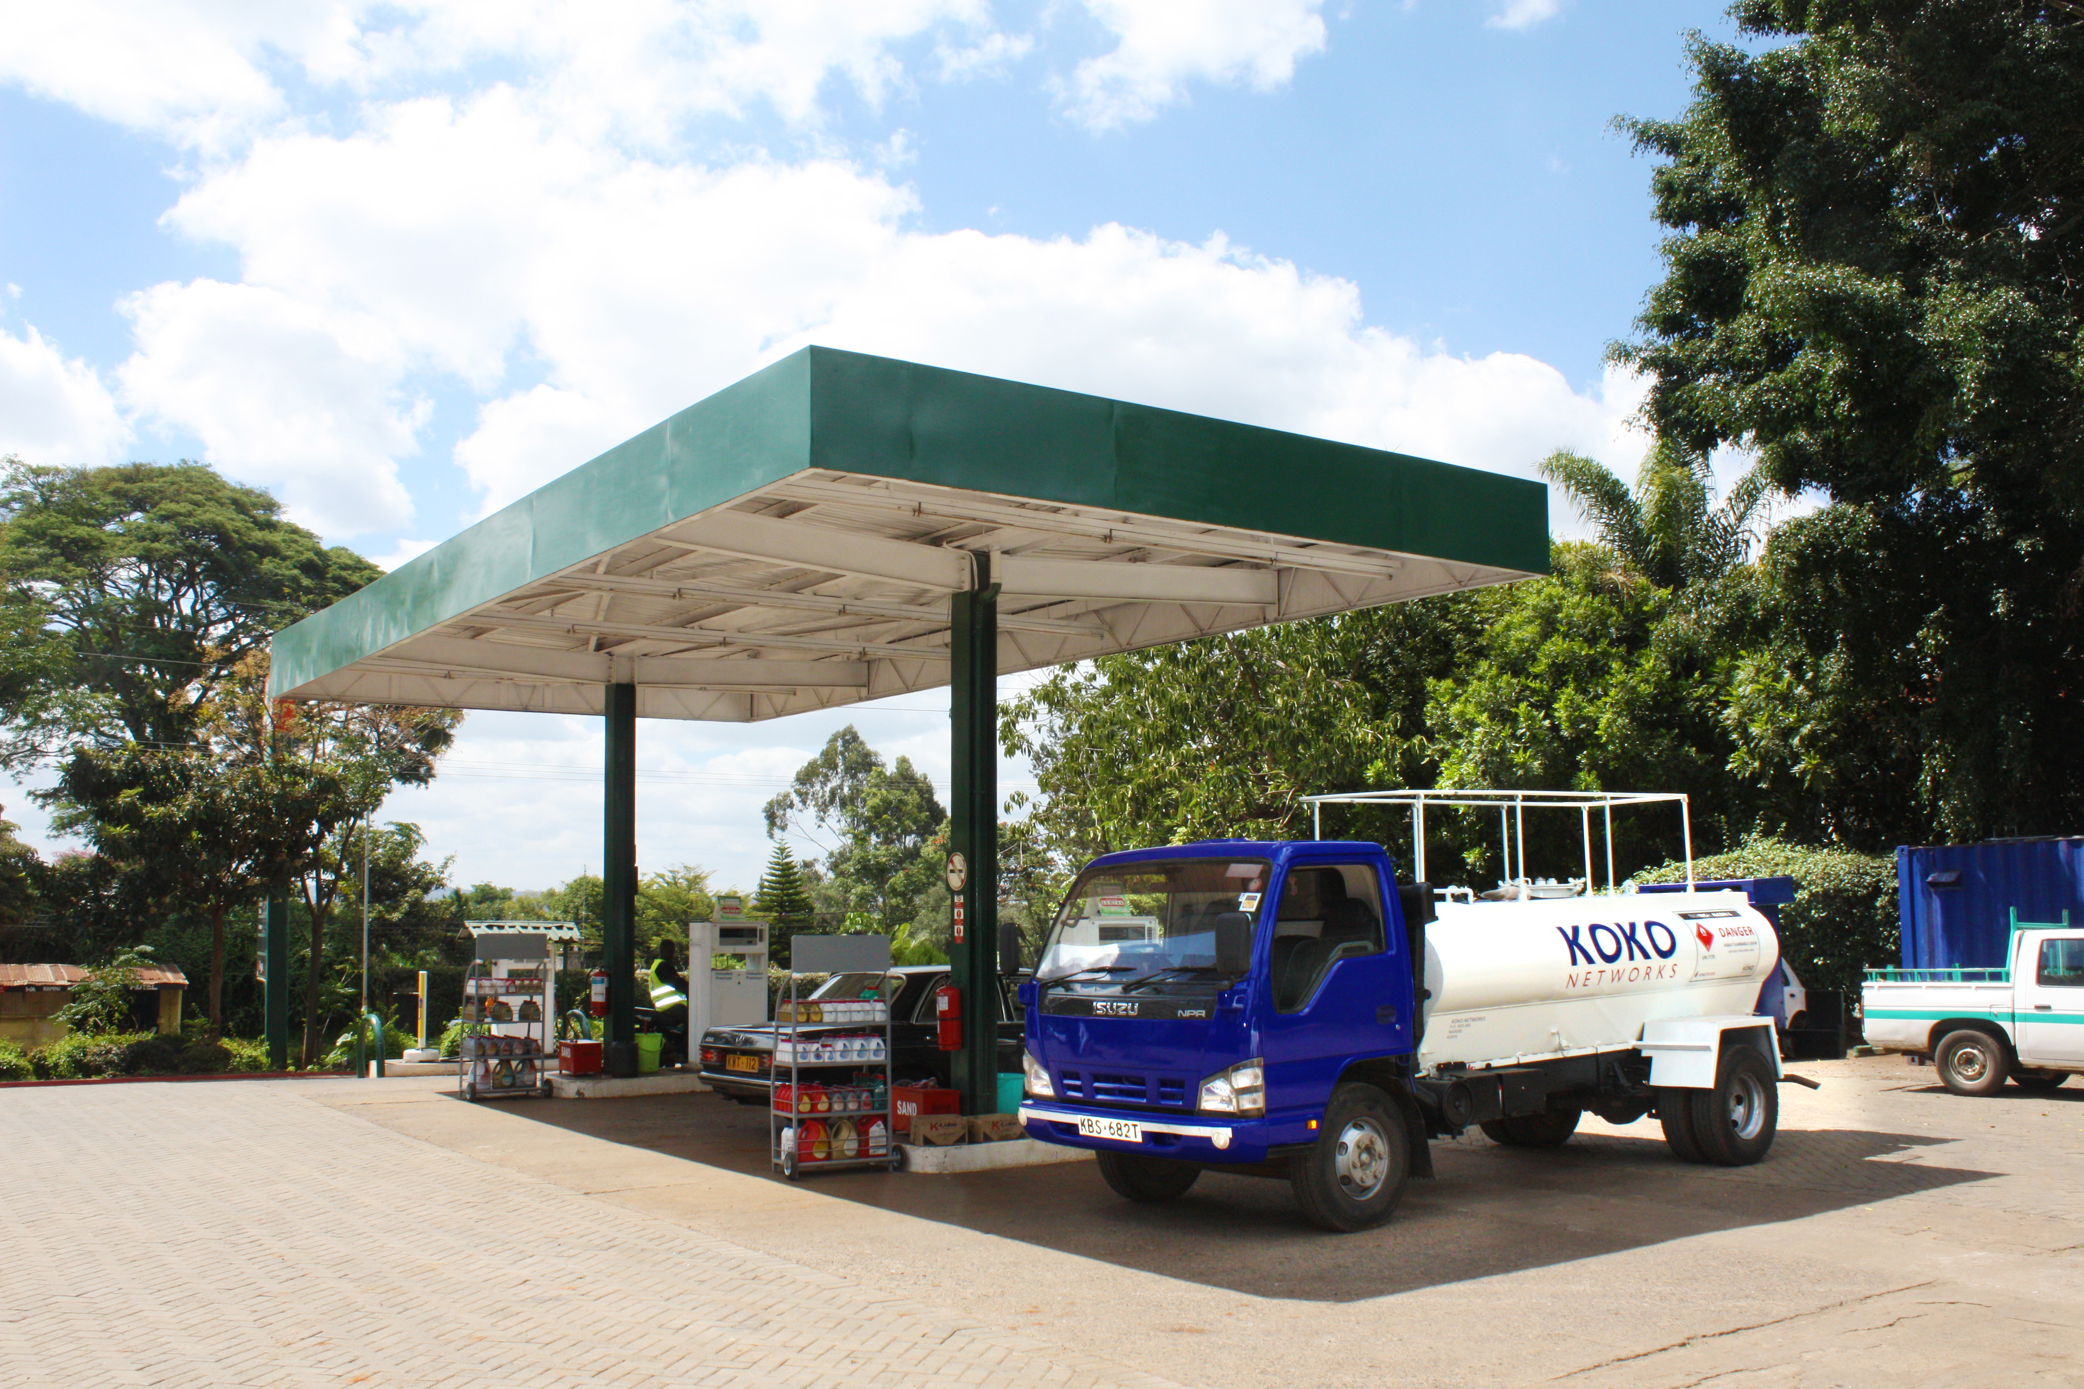
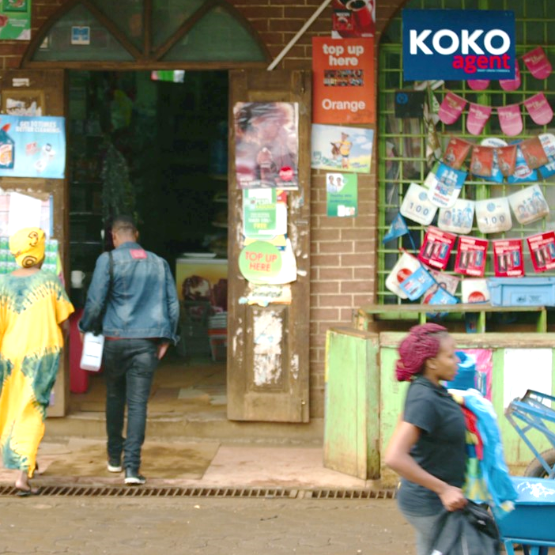
SCOPE OF SOFT LAUNCH
1
2
3
4
5
1,000 customers – cash upfront & layaway purchase options
myKOKOapp referrals
10 KOKO Agents across 10 different neighbourhood types
1 Smart Microtanker and 1 petrol station
+ MAP of Agent locations incl. Agent pics / key stats

Slide 5



CUSTOMER ACQUISITION CURVE – SNAPSHOT @ 3 Nov 2017
 | CURRENT ACQUISITION RATE | HARD LAUNCH TARGET (INCL. MARKETING CAMPAIGN)
 | 3 Customers per KP per week | 5 Customers per KP per week
 | Layaway Patterns | Active layaway program serving all income brackets
 | myKOKO app referrals & downloads | App download 118% of customer acquisition

Slide 6
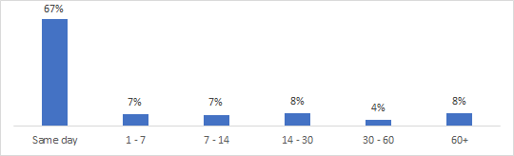
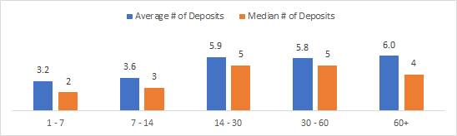
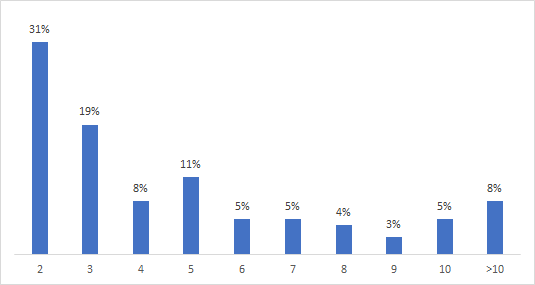
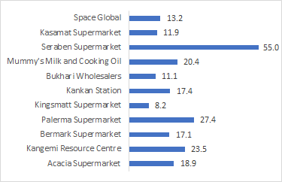
Average and median number of deposits by amount of time taken to save:
CUSTOMER LAYAWAY PATTERNS
Distribution of days taken to save:
There is a slight trend towards saving taking longer in lower income agent neighborhoods
Distribution of number of deposits for those in the savings program (not same day purchasers)

Slide 7
CUSTOMER APP DOWNLOADS
myKOKOapp referrals & downloads:
240 App downloads
170 Customer downloads
36 Customers referred in the month of October with 4 referral sales.
Slightly over half of the customers were able to install the app
Hard Launch Target (incl. marketing campaign):
Referral growth rate 60%
App download 143% of customer acquisition
The most common blocker to installing the app was the phone refusing to download from the Play Store

Slide 8
FUEL USAGE PATTERNS
Current Average Usage per Customer:
Fuel Sales by week:

Slide 9
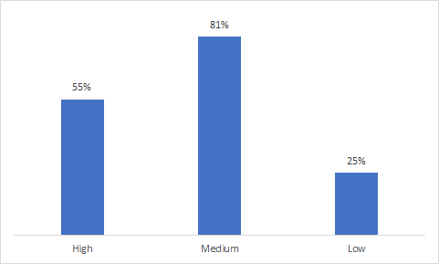
UNDERSTANDING OUR CUSTOMERS AND CREATING BRAND LOYALTY THROUGH EDUCATION ON MONEY SAVING TIPS
81% of our customer earn between $100 - $500 per month
Average household size is 4.3 persons
Households with a monthly income of $100-$200 has the greatest monthly ARPU
Majority of customers switched from 1 burner gas stove, followed by mix fuel user with 1 burner gas stove and kerosene
Our customers can save money using Smartcook if we educated them on cooking best practices
Only 25% of customers use the "Low" setting on their stove, even though simmering food on Low saves significantly on fuel
58% of customers do not turn the regulators up and down at all while cooking
17% of customers do not always cover their pots while cooking, and could save significantly by changing this behavior
56% of customers said they had dropped kerosene after ~30 days of use, and 11% said they had dropped charcoal

Slide 10
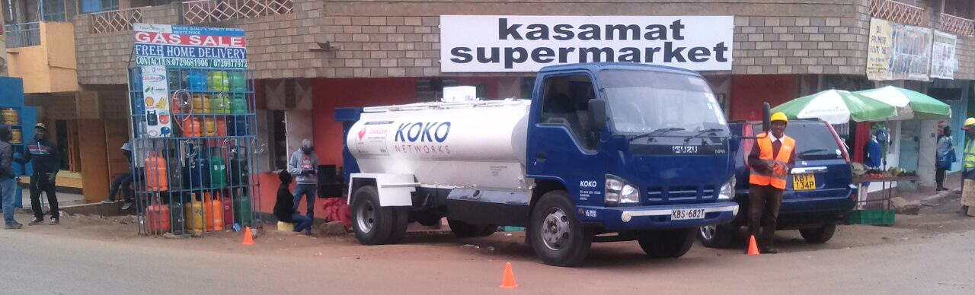
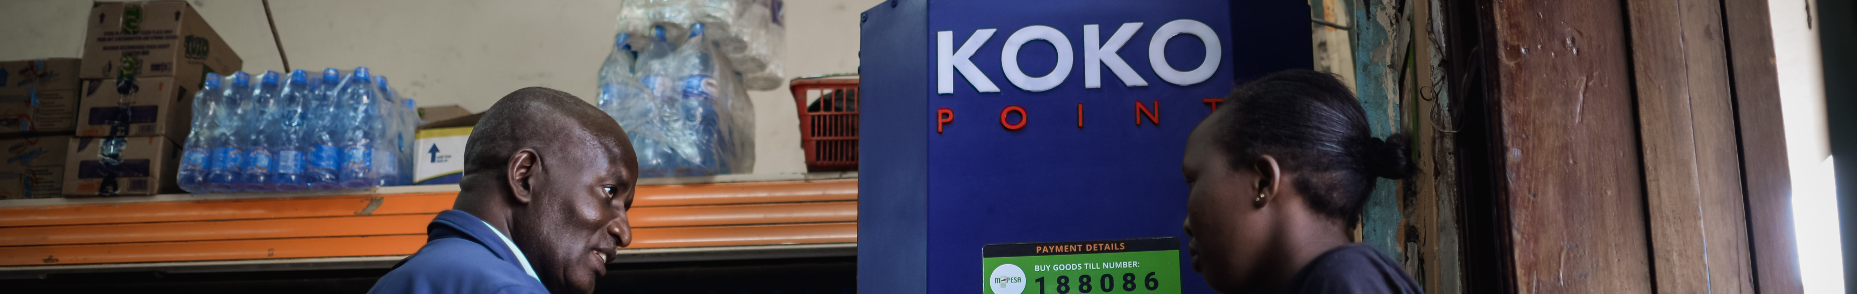
AGENT PERFORMANCE
Add Agent Shop images and improve chart
8.68
Net Promoter Score = 86.8
Net promoter score
Location | Throughput per day | ARPU | No. of Customers | No. of Layaway Customers | Data of Install | 50K Repayment Date
Seraben | 4.28 | 0.09 | 77 | 52 | April 2017 | Dec 2017
KRC | 2.14 | 0.09 | 27 | 31 | May 2017 | Jan 2018
Palerma | 5.98 | 0.19 | 33 | 29 | May 2017 | Jan 2018
KanKan | 5.61 | 0.12 | 69 | 73 | May 2017 | Nov 2017
Bukhari | 4.29 | 0.14 | 29 | 21 | July 2017 | Mar 2018
Kasamatt | 1.42 | 0.07 | 25 | 36 | June 2017 | Feb 2018
Bermark | 1.21 | 0.12 | 15 | 34 | June 2017 | Feb 2018
Mum's Oil and Milk | 2.49 | 0.26 | 8 | 9 | Aug 2017 | May 2018
Space Global | 3.68 | 0.15 | 30 | 22 | Sept 2017 | Feb 2018
Acacia Supermarket | 8.39 | 0.24 | 47 | 39 | Sept 2017 | Feb 2018
KingsMatt Supermarket | 4.27 | 0.47 | 14 | 35 | Oct 2017 | Mar 2018

Slide 11
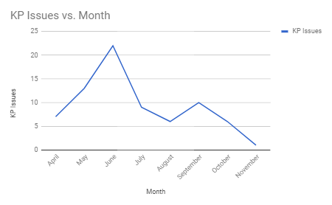
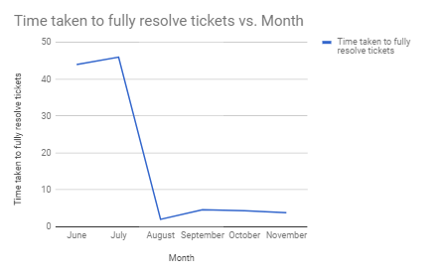
OTHER TECHNICAL DATAPOINTS FROM SL
Improving Service Excellence
Add Customer ticket graph -
With the use of network health data and implementing a quarterly maintenance checklist, we have been able to reduce the number of KP issues and ensure the maximum KP uptime.
KP uptime, response time
Call centre response times (graph), incidents, returns
MT refill time / KP

Slide 12
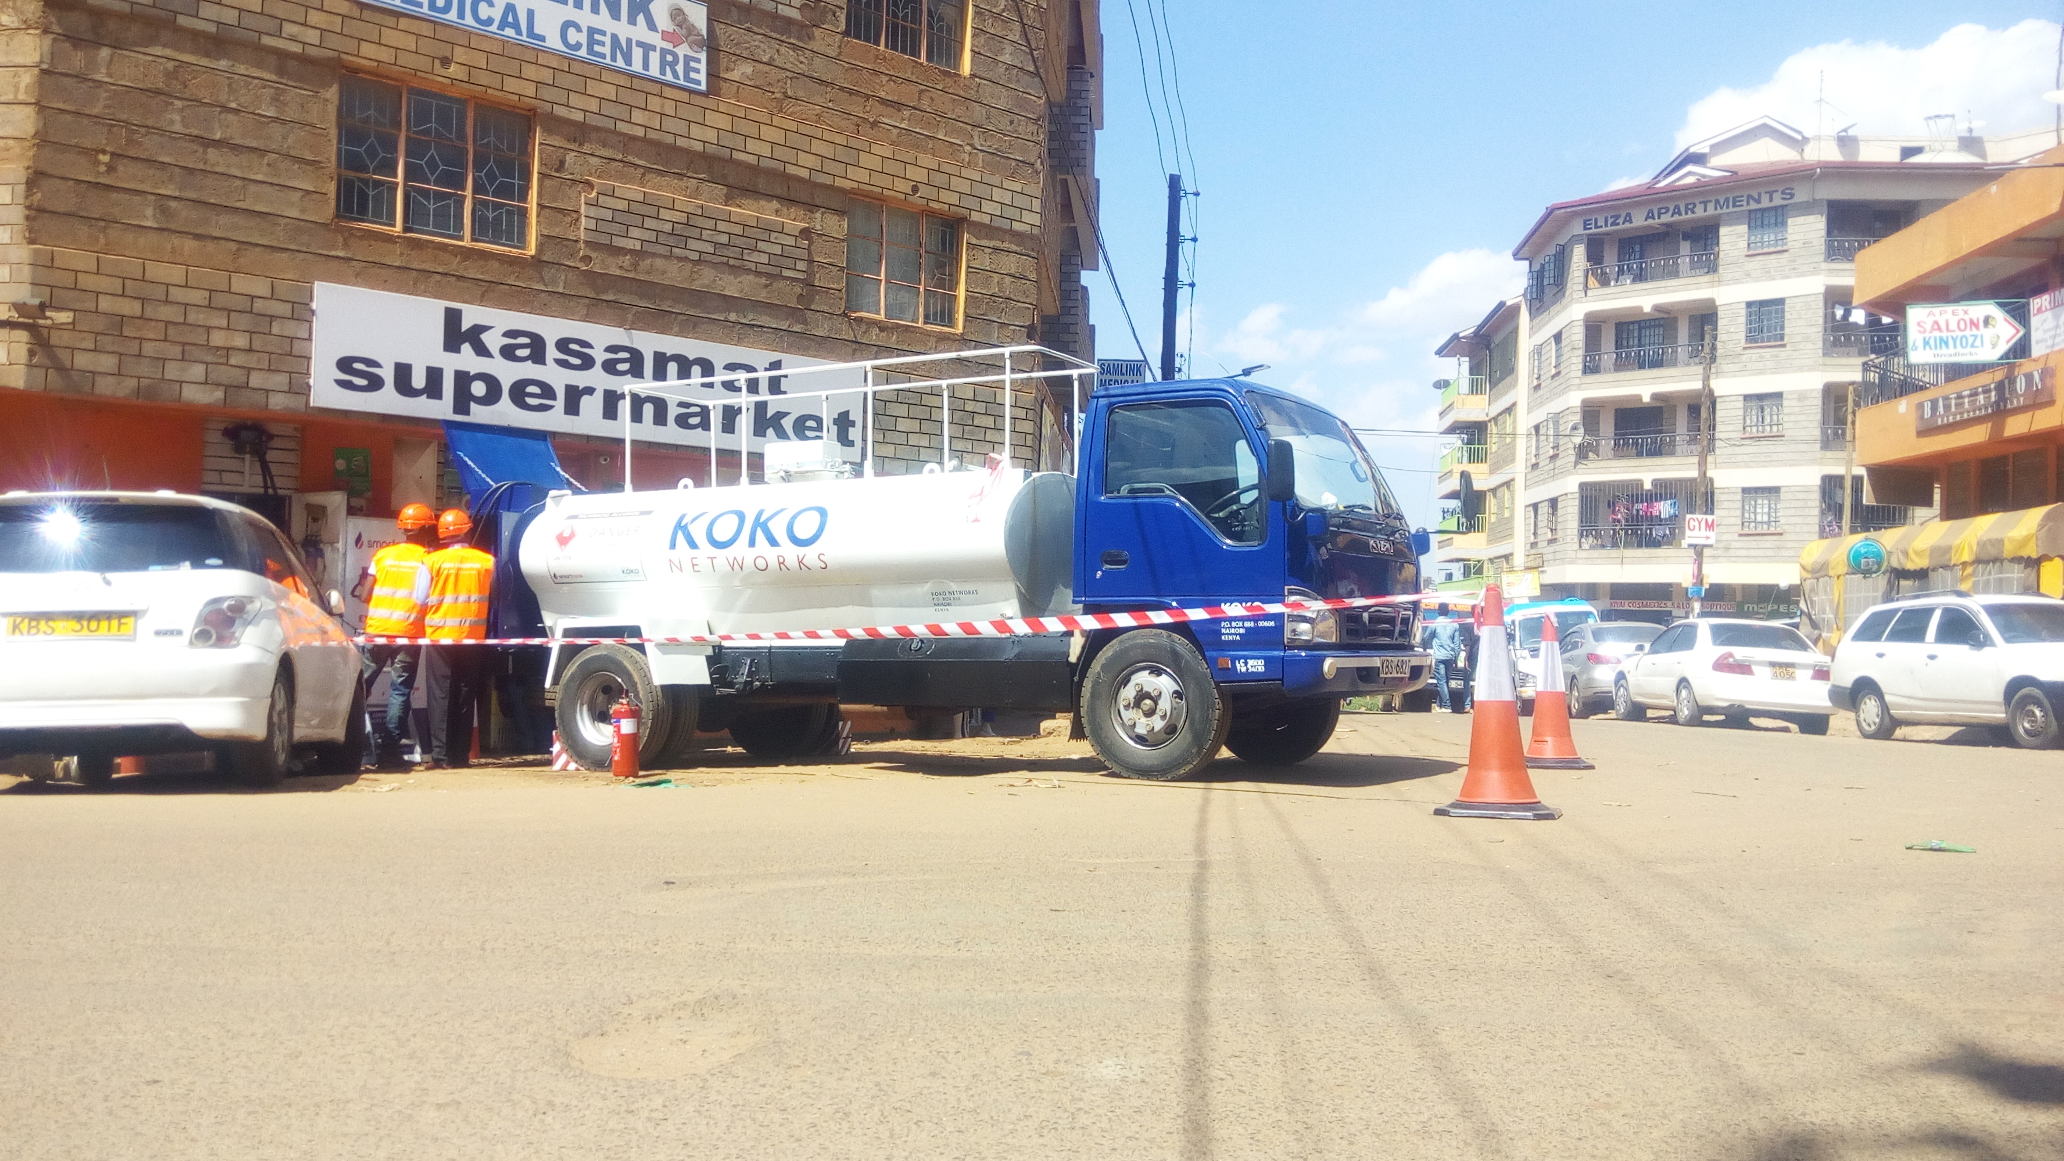
OTHER TECHNICAL DATAPOINTS FROM SL
MicroTanker and KP Refills
Add images of MT and agent refills- Amanda will add data points
KP uptime, response time
Call centre response times (graph), incidents, returns
MT refill time / KP

Slide 13
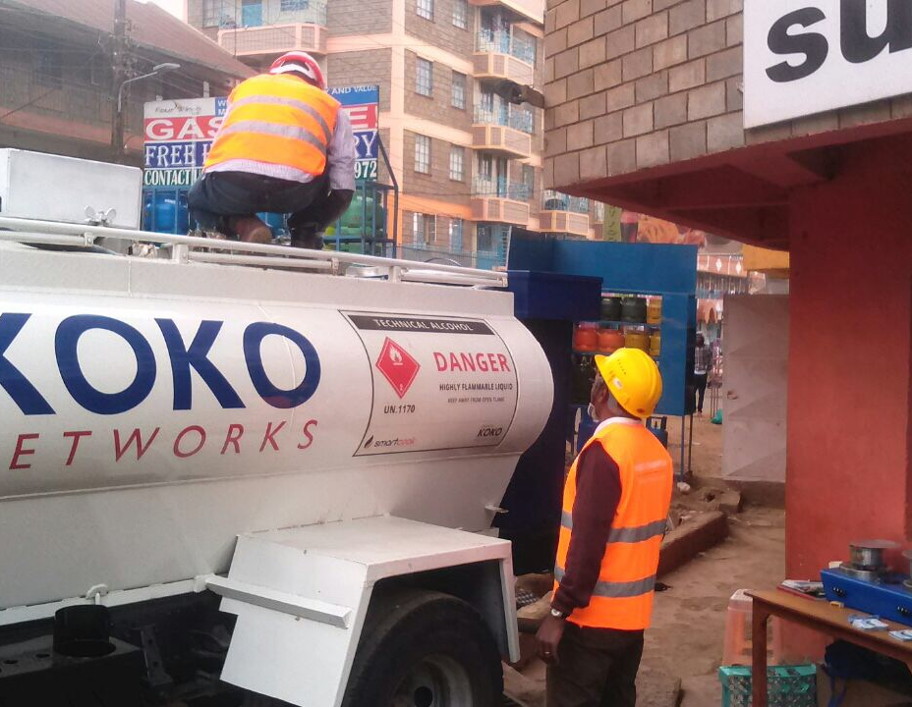
HSEQ PROGRAM
Drastic reduction in stove over-fill incidents after implantation of stove modification
Completed Training - First Aid and Fire Fighting
HSEQ KPIs submitted for non Champs
Safety slogan implanted
HSEQ Philosophy developed
Regulatory endorsements - Fire permit – Palerma Supermarket & Acacia
Certified calibration of KP
PPE acquired and adhered to
Above average HSEQ awareness from some “non- HSEQ champ” staff
Introduction of Stove Safety Campaign with Customers
Add safety images -
Employees in safety gear
First aid and fire training

Slide 14






STATUS ON REGULATORY ENDORSEMENTS
Fire Clearance Cert – Acacia & Palerma
Update design to work with the rest of the presentation
Stove COC, TA tests, KP No objection
OK on KOKO Tech, Await Agent Inspection
Pending ERC License
OK on KP Calibration. Await IS endorsement and W&M Approval.

Slide 15
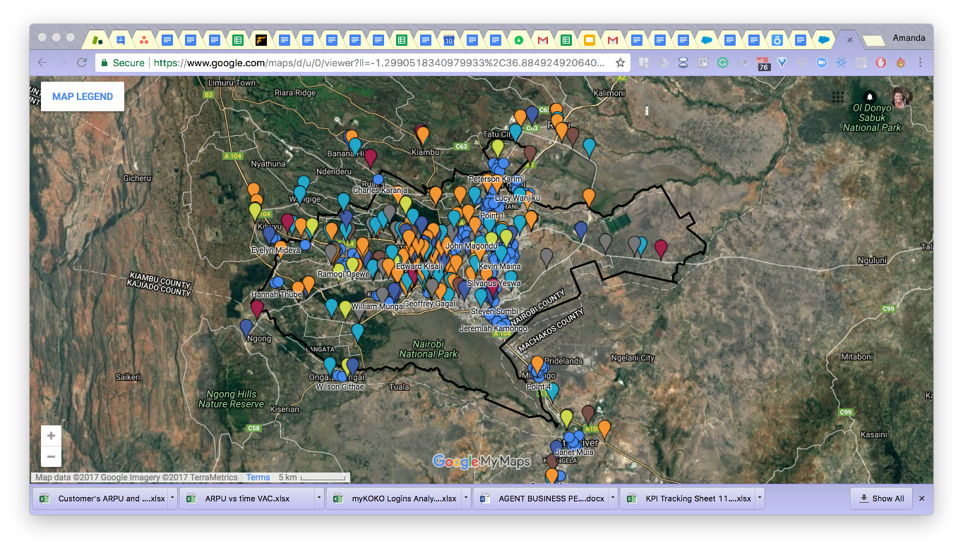
AGENT ACQUISITION – 40% COMPLETE (414 Reservations)
Acquisition Targets and Timelines:
500 Agent Reservations – November 20th
750 Agent Reservations – December 13th
950 Agent Reservations – December 31st
1300 Agent Reservations - January 31st
1450 Agent Reservations – Feb 18th
1000 Contracted Agents February 28th
Paid $500
Secured $1500 loan with our banking partner
Site inspection and modifications complete

Slide 16
OILCO CONCESSIONING PROCESS
Process
Counterparties
Milestones
Expected Award Date of Concession
T + V + others

